Slide 1

Regex 101
A Brownbag by Anthony McKale
Associate Director, DevOps and Cloud
Date 07 - 2023

Slide 2
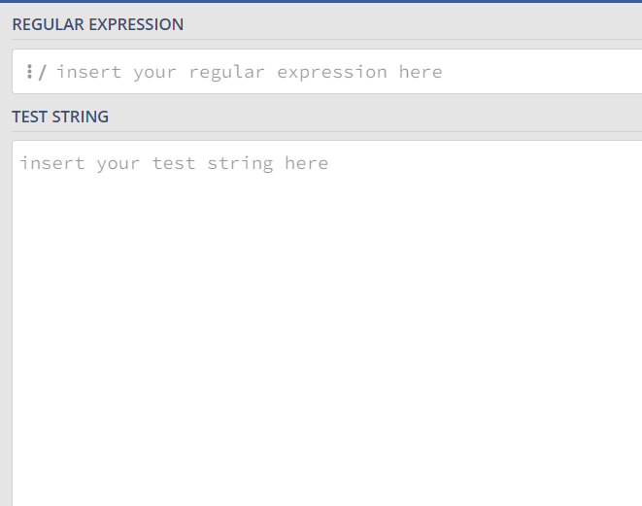
Now for something different
Open camera on glass board
Open up a copy of https://regex101.com/

Slide 3
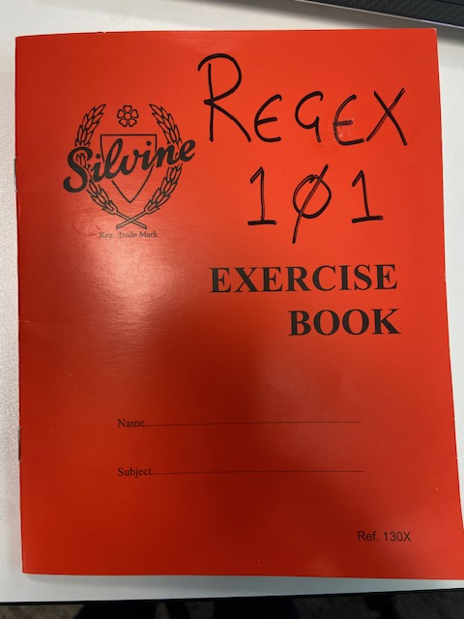

Slide 4
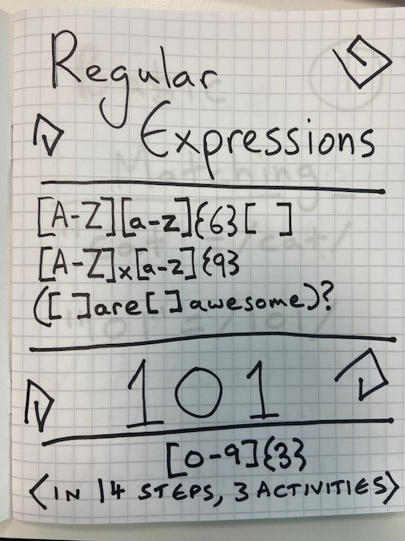
https://regex101.com/

Slide 5
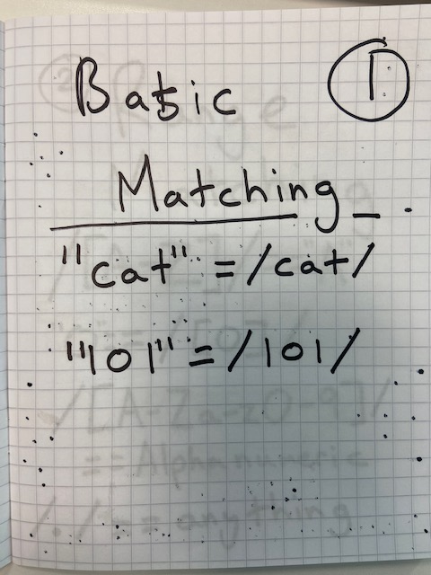
/CHARACTERS/
https://regex101.com/

Slide 6
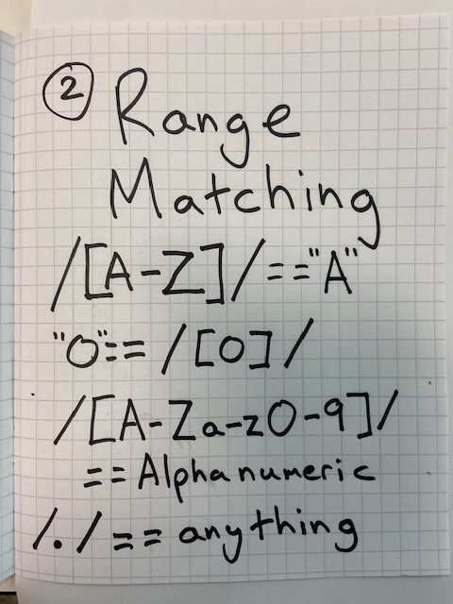
/ [RANGE] / / [0-9] / / [0-9a-z] /
https://regex101.com/

Slide 7
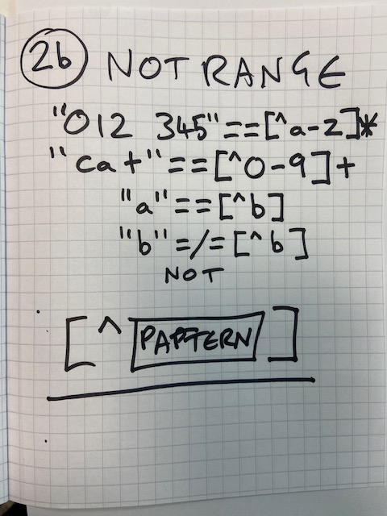
/ [^RANGE] / / [^0-9] / / [^0-9a-z] /
https://regex101.com/

Slide 8
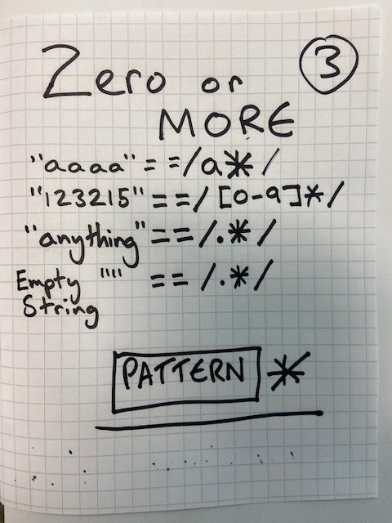
/ PATTERN* / / [0-9]* /
https://regex101.com/

Slide 9
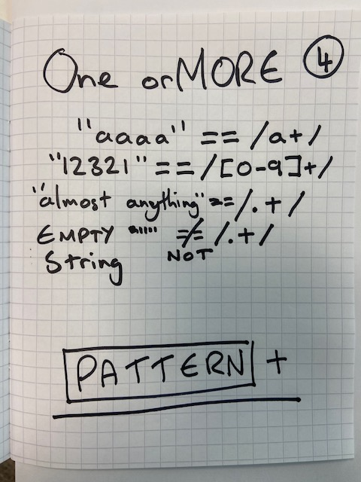
/ PATTERN+ / / [0-9]+ /
https://regex101.com/

Slide 10
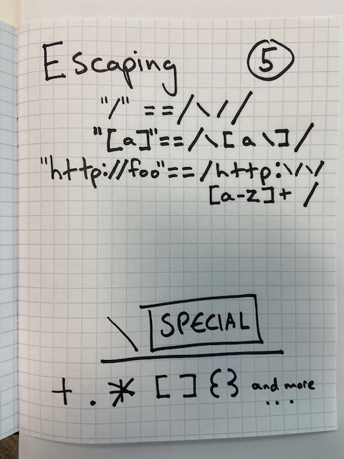
/ \SPECIAL / / \[0-9\]\+ /
https://regex101.com/

Slide 11
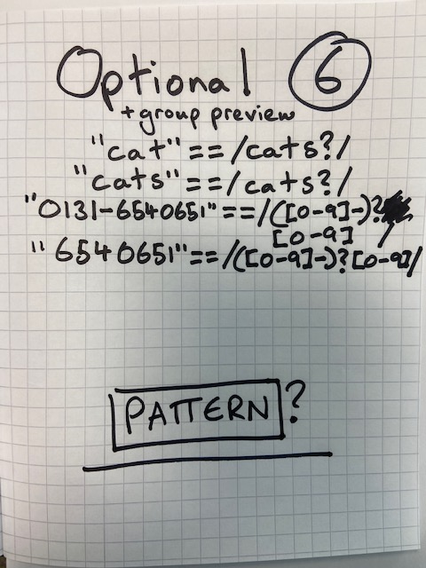
/ PATTERN? / / a([0-9]+)? /
https://regex101.com/

Slide 12
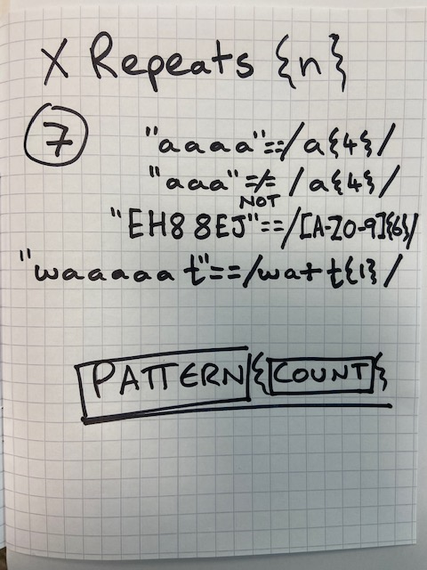
/ PATTERN{count} / / [0-9]{3} /
https://regex101.com/

Slide 13
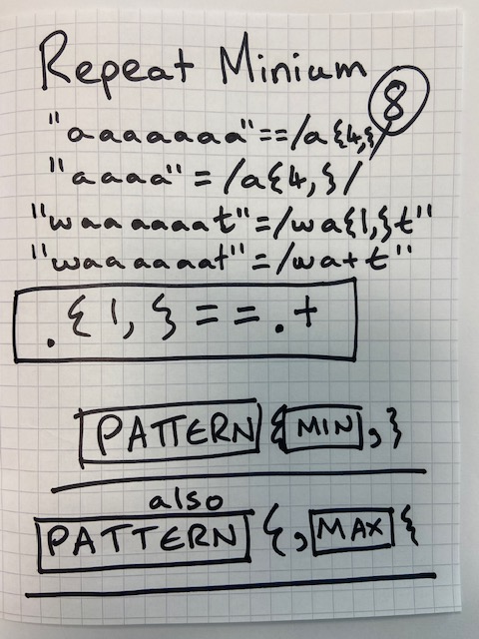
/ P{min,max} / / [0-9]{1,3} /
https://regex101.com/

Slide 14
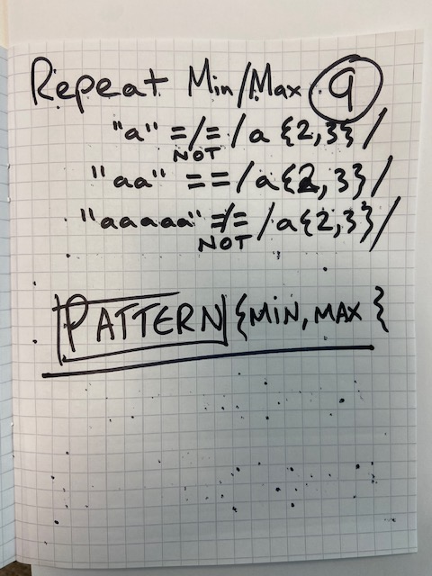
/ P{min,max} / / [0-9]{1,3} /
https://regex101.com/

Slide 15
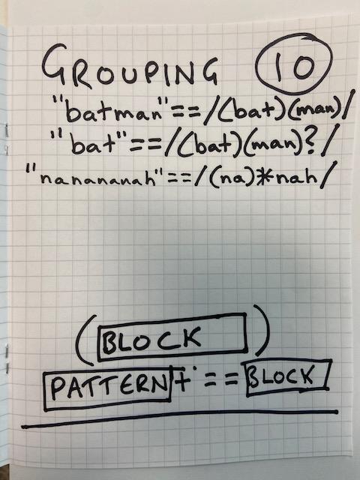
/ (PATTERNS) / / ([a-z]+[0-9]+) /
https://regex101.com/

Slide 16
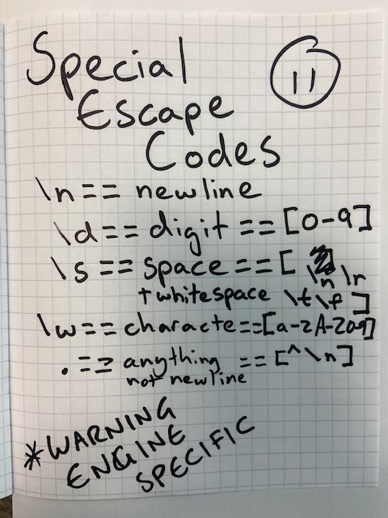
/ \CODE / / \n / / . / == [^\n]
https://regex101.com/

Slide 17
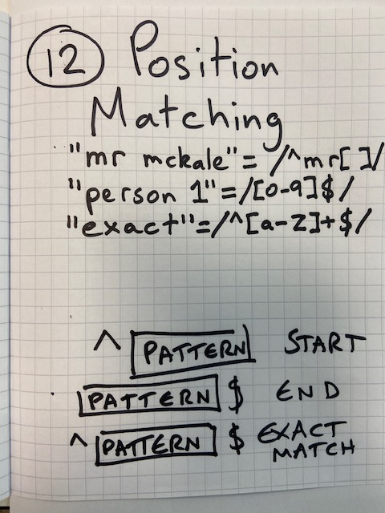
/ ^EXACT$ / / ^START / / END$ /
https://regex101.com/

Slide 18
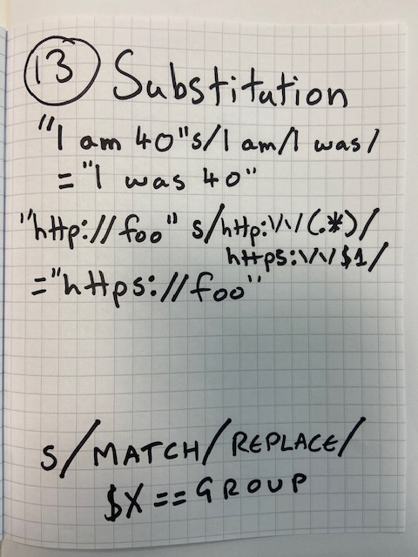
s/MATCH/REPLACE/ $0 = whole match $X = group
https://regex101.com/

Slide 19
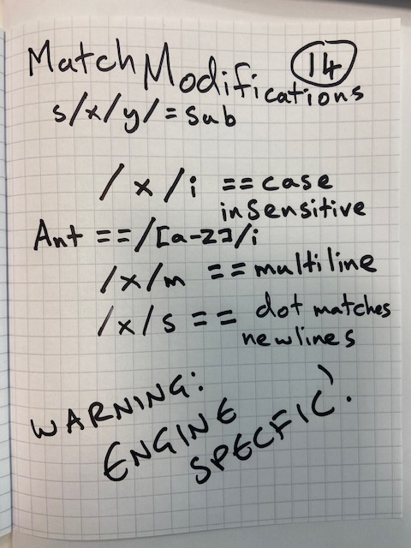
/MATCH/modifier
https://regex101.com/

Slide 20
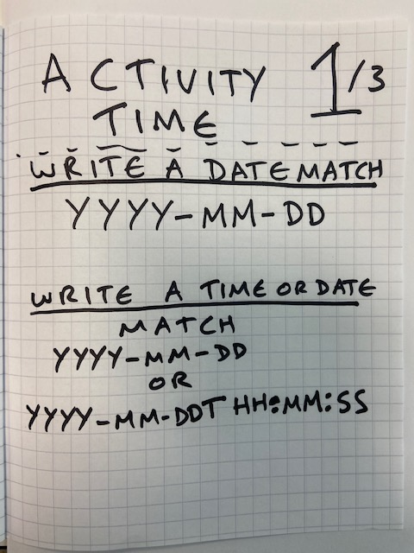
MATCH 2022-08-22 NOT: 0110-56-33
https://regex101.com/

Slide 21
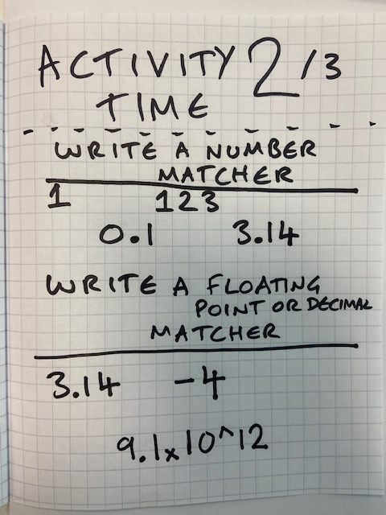
MATCH 1 44 50.566 0.11 -33 NOT: 033.33
https://regex101.com/

Slide 22
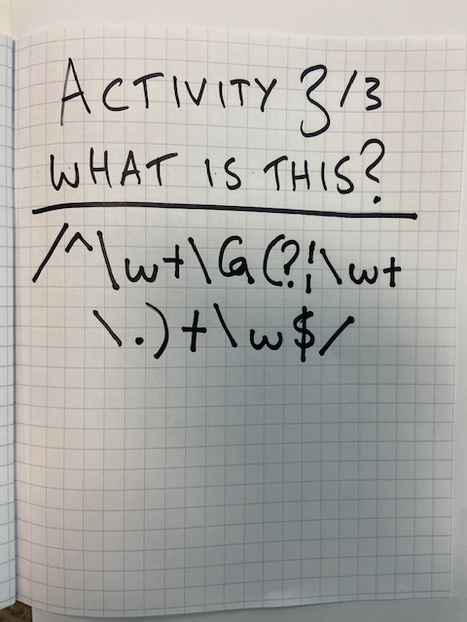
MATCH ? WHAT AM I ? Put answers in chat once everyone’s ready
https://regex101.com/

Slide 23
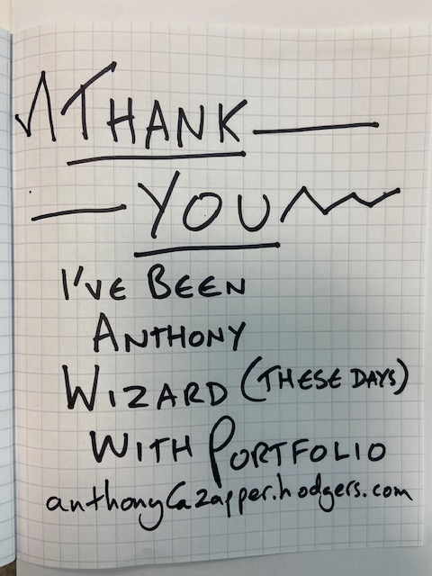
https://regex101.com/

Slide 24

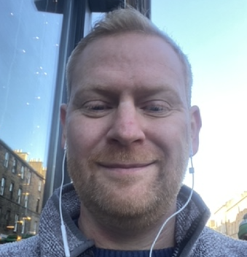
Contact
Anthony McKale
Associate Director, Cloud and DevOps
E: anthony.mckale@6point6.co.uk
LinkedIn: https://www.linkedin.com/in/anthonymckale
I've been Anthony "Zapper" McKale
Hopefully: I've Educated, Informed, and even Entertained Thank you, for your audience 6point6.co.uk
Notes:
Add logos if you sit on any boards next to your name.

